Slide 1

P peline
The Data
Acquiring Data: Practice
© Jennifer Mankoff
The Data Pipeline; HCII; Spring 2014

Slide 2
Goals
After this, you should be able to:
Explain how data is typically accessed on the web
Explain the basic process for secure data retrieval using OAuth 2.0
Adapted from http://www.fordham.edu/economics/Vinod/correl-regr.ppt

Slide 3
Practice: Getting at data

Slide 4
Lots of ‘existing’ data
http://data.cmubi.org/classroom-news/somegreatsourcesofdata

Slide 5
Not all of it is packaged up for you
Web Scraping
Web APIs
Programmatic interface to server side data and functionality
We like REST APIs best
Lots of websites have them
http://en.wikipedia.org/wiki/List_of_open_APIs
http://www.programmableweb.com/apis/directory
http://www.webdesignerdepot.com/2011/07/40-useful-apis-for-web-designers-and-developers/
https://www.data.gov/developers/apis
Notes:
Api cons: Things can change
Much less bad than scraping though!

Slide 6
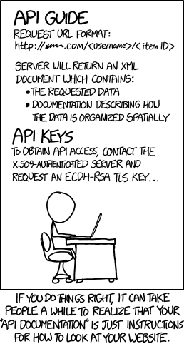
API GUIDE ALA XKCD
http://xkcd.com/1481/

Slide 7
Using a Web API
Construct a URL
Post it to the Server
Collect the Response (often XML or JSON)
Parse and Act
Have to start with the documentation
Typical flow

Slide 8
Why should the server trust you?
You have the user’s password (should you?)
Would you store it?
What else could you do with it?
How do users revoke access?

Slide 9
Why should the server trust you?
You have the user’s password (should you?)
You have an API key
Reasonable for publicly available data
Lets the owner of the application track use; enforce rules & revoke access

Slide 10
Why should the server trust you?
You have the user’s password (should you?)
You have an API key (how do you get it?)
Once:
Every URL: includes the key
Construct a URL
Post it to the Server
Collect the Response (often XML or JSON)
Parse and Act
Manually Register for Key
Notes:
This is what we will do for Byte 2 and others

Slide 11
Why should the server trust you?
You have the user’s password (should you?)
You have an API key
You use OAuth 2.0
Gives the Resource Owner control
Gives the application owner control: Resource Server serves the API Authorization Server serves the key
You are the Client

Slide 12
Typical OAuth 2.0 Flow
Manually Register Client
client_id
client_secret
Client
OAuth Provider

Slide 13
Typical OAuth 2.0 Flow
Manually Register Client
client_id
client_secret
Client constructs URL
OAuth Provider
GET auth_uri
client_id=…
redirect_uri=…

Slide 14
Typical OAuth 2.0 Flow
Manually Register Client
client_id
client_secret
Does the user want this?
Client
OAuth Provider

Slide 15
Hi user!
[served by Authorization Server, not you]
Yes, I grant access
No, I don’t grant access

Slide 16
Typical OAuth 2.0 Flow
Manually Register Client
client_id
client_secret
Client
OAuth Provider
redirect_uri
code=foo

Slide 17
Typical OAuth 2.0 Flow
Manually Register Client
client_id
client_secret
Client constructs URL
OAuth Provider
POST access_token
client_id=…
client_secret=…
code=…

Slide 18
Typical OAuth 2.0 Flow
Manually Register Client
Get access_token
Client constructs URL
OAuth Provider
result: access_token=…
Notes:
Access token tells server

Slide 19
Typical OAuth 2.0 Flow
Manually Register Client
Get access_token
(1) (1+)
Every URL: includes the access_token
Construct a URL
Post it to the Server
Collect the Response (often XML or JSON)
Parse and Act
Notes:
Access token tells server who you are and which user you are logged in as …
----- Meeting Notes (1/23/14 09:47) -----
update first line

Slide 20
Some OAuth extras
Tokens will eventually expire
There are multiple types of access
A client can request access but scope it to only part of an API

Slide 21
Summary
Lots of existing data
Data streams are a valuable source of data
Need to address security issues
OAuth (2.0) is the current standard
Gives the user / data source control over whether you have access & for how long
Once you get permission you use a key to access the data

